Slide 1
Library management system
Relaxed style presentation
30.04.24
Duan Youzhen&Ding Yeming

Slide 2
Tasks
Users and administrators can log in
Users can borrow books
Users can view their history of borrowing books

Slide 3
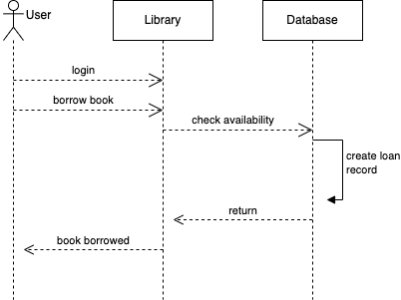
Sequence Diagram

Slide 4
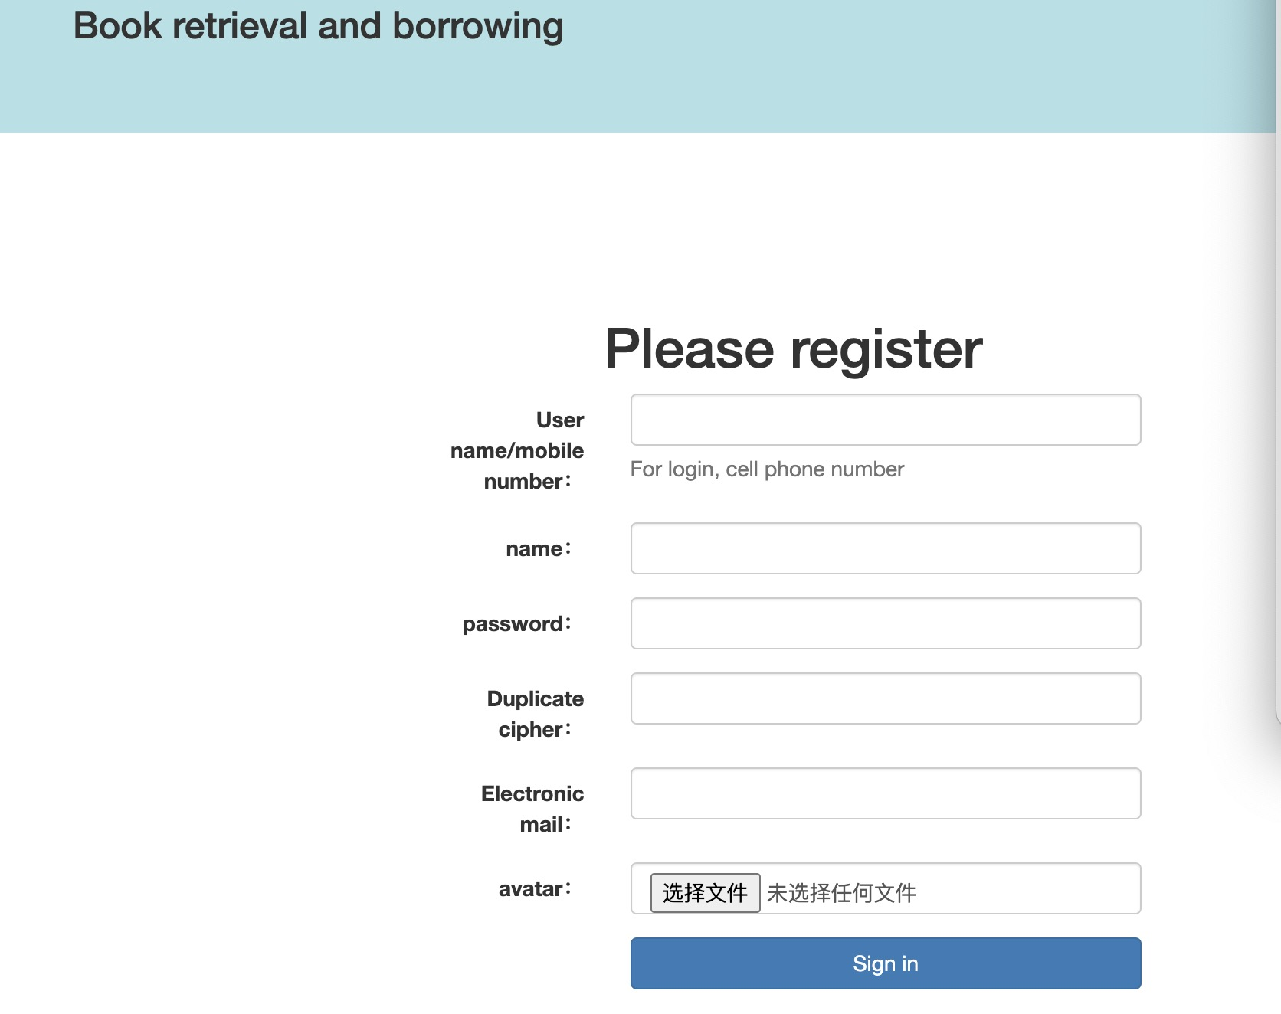
User registration

Slide 5
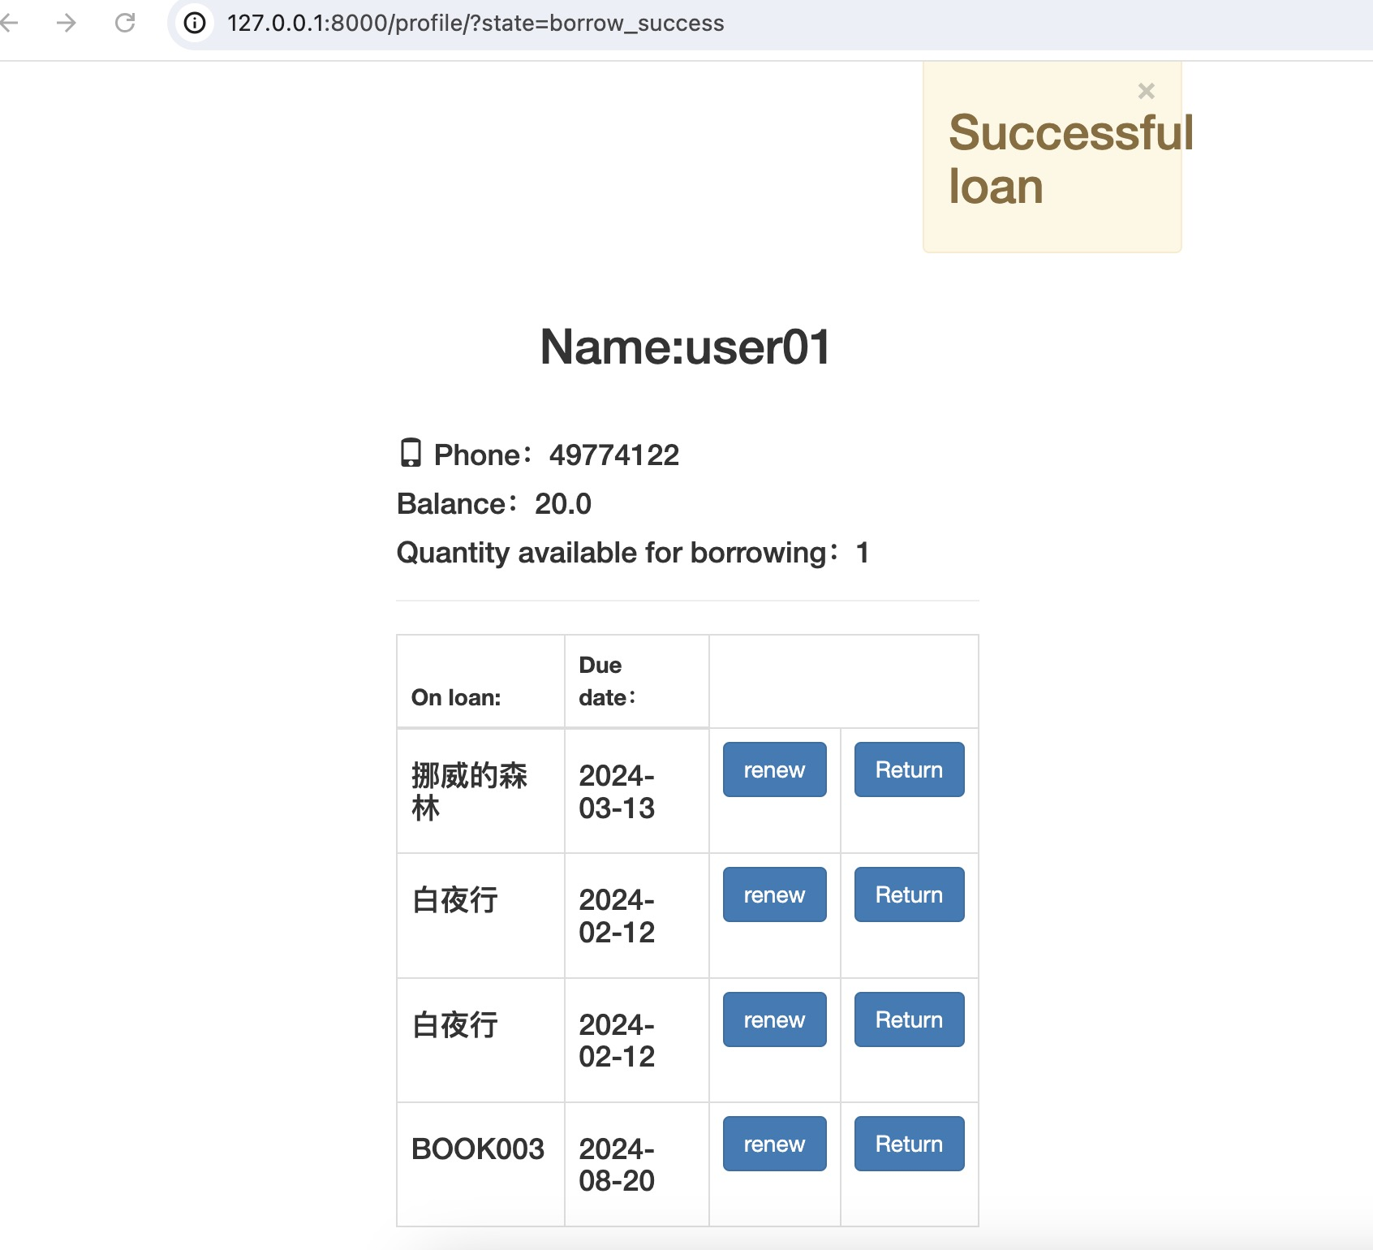
The user borrowed successfully

Slide 6
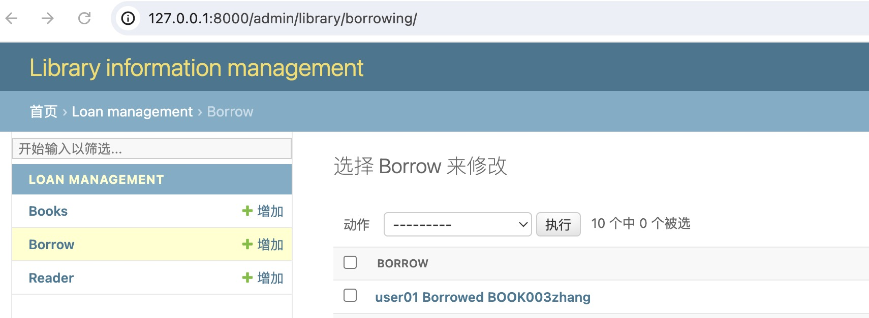
Administrators can detect user borrowing records

